Slide 1
F2F Meeting
16-09-24

Slide 2
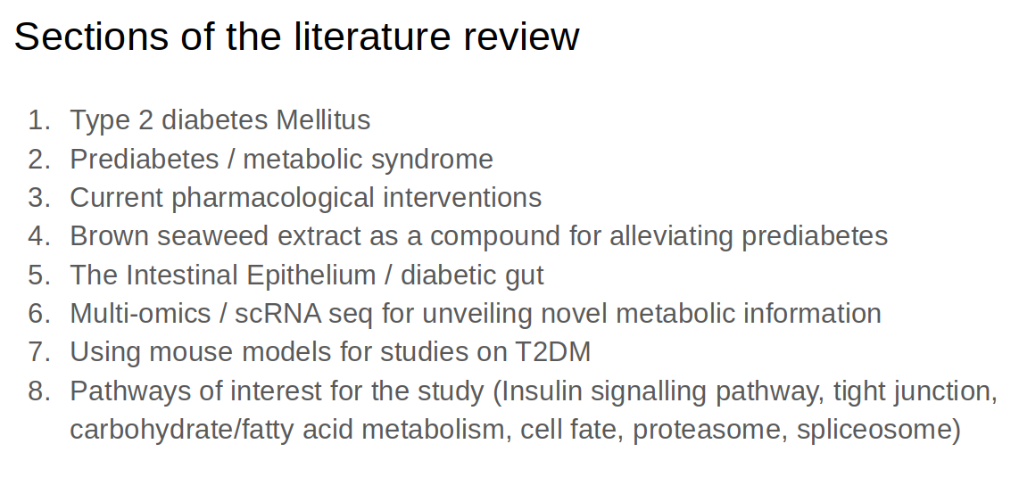

Slide 3
Updates on the literature review
Produced a draft on Friday 13th
Structure needed serious revising and refocussing on literature relevant to the project
13th – 17th/18th refocussing the literature review.
Details in the next slides

Slide 4
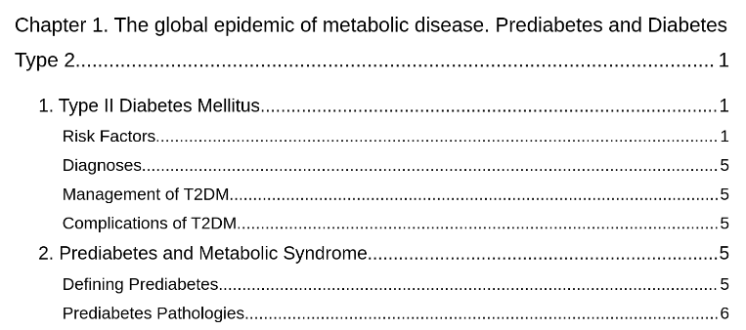
Literature Review Structure (Before)
- Structure originally consisted of 4 chapters
- Chapter 1 had too much detail about T2DM and Prediabetes (8 pages)
- Chose to condense important relevant details into an introductory paragraph in the lit review.

Slide 5
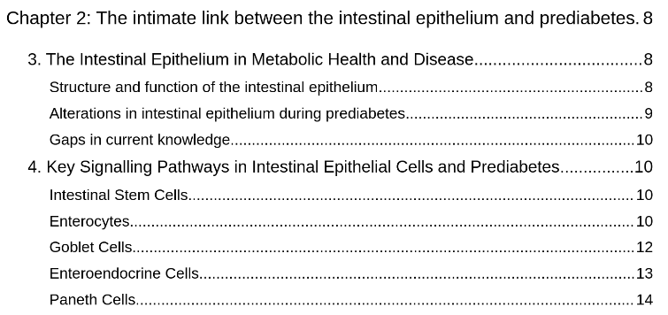
Literature Review Structure (Before)
- The structure previously focussed on a cell to cell level, missing relevant larger ideas in the literature

Slide 6
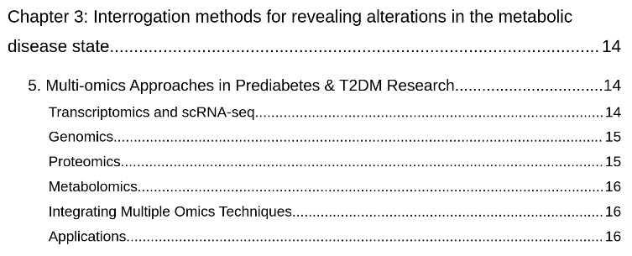
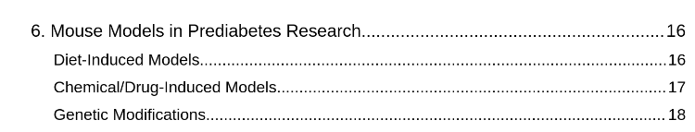
Literature Review Structure (Before)
- Too much detail on multiomics, not enough detail on scRNA-seq describing why I am choosing the methods I am using.

Slide 7
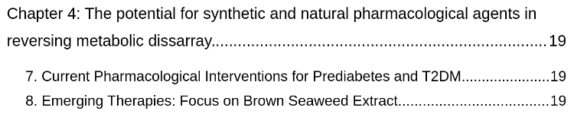
Literature Review Structure (Before)
- This section remains in the literature review although I am finding it hard to connect it to my project …

Slide 8
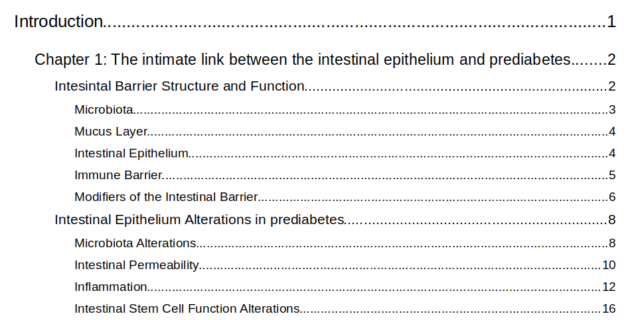
Literature Review Structure (Now)
- Literature Review now 3 chapters

Slide 9
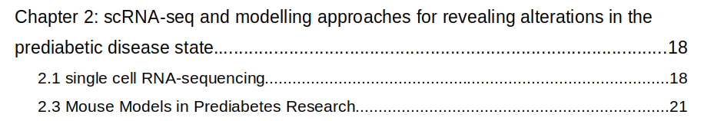
Literature Review Structure (Now)
- Refocussed on scRNA-seq, upstream / downstream techniques

Slide 10
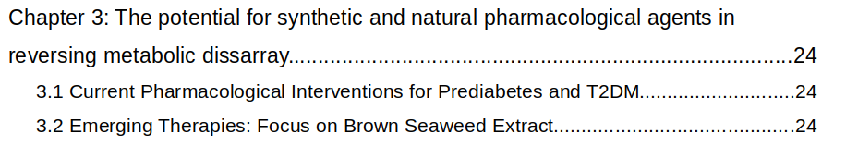
Literature Review Structure (Now)
??

Slide 11
Problems
Unsure how chapter 3 fits into the project

Slide 12
Timeline
17th / 18th first complete draft
Sunday 22nd results / methods complete
Saturday 28th Final Draft complete

